Slide 1
Design and Analysis of Algorithms
CSC 413
LECTURE 5
Topic: Recurrence Relations and Recursive Algorithms
Lecture Note Presentation

Slide 2
Recursion Fundamentals
Definition: Recursion is a programming technique where a function solves a problem by calling itself with a smaller version of the same problem until it reaches a base case.
Key Components of Recursion:
Example: (factorial can be defined recursively as follows:
  function fact(n):
  if n == 0 or n == 1:
  return 1 ← base case
  else:
  return n * fact(n-1) ← recursive case
part | explanation
Base Case | condition where recursion stops. prevents infinite loop.
Recursive Case | the part where the function calls itself again but with smaller input
Progress to base | every recursive call MUST move toward base case

Slide 3

Recurrence Relations
A recurrence relation is a mathematical expression that defines a sequence in terms of its previous terms. In the context of algorithmic analysis, it is often used to model the time complexity of recursive algorithms.
A recurrence equation relates the value, an, of a sequence in terms of some or all of its past values. General form of a Recurrence Relation: $a_{n}=f(a_{n−1, }a_{n−2, },a_{n−3, }$…, $a_{n−k, }$). where f is a function that defines the relationship between the current term and the previous terms
Why Recursion matters in complexity analysis: Recursive algorithms lead naturally to a mathematical expression relating T(n) to T(smaller inputs n−k). This mathematical expression is called Recurrence Relation.
Formulating Recurrence Relations: Given a recursive algorithm, we write T(n) = cost of function for input size n.
Example | Recurrence Relation
Fibonacci Sequence | F(n) = F(n-1) + F(n-2)
Factorial of a number n | F(n) = n * F(n-1)
Merge Sort | T(n) = 2*T(n/2) + O(n)
Tower of Hanoi | H(n) = 2*H(n-1) + 1
Binary Search | T(n) = T(n/2) + 1

Slide 4
Solving Recurrent Relations
Solving recurrent relations refers to the techniques for converting recursive definitions to closed formulas.
The common techniques are:
Technique | When used
Iteration / Back substitution | simple recurrences, can expand repeatedly
Substitution method | assume solution form then prove correctness by induction
Master theorem | divide & conquer recurrences of form T(n) = aT(n/b) + f(n)

Slide 5
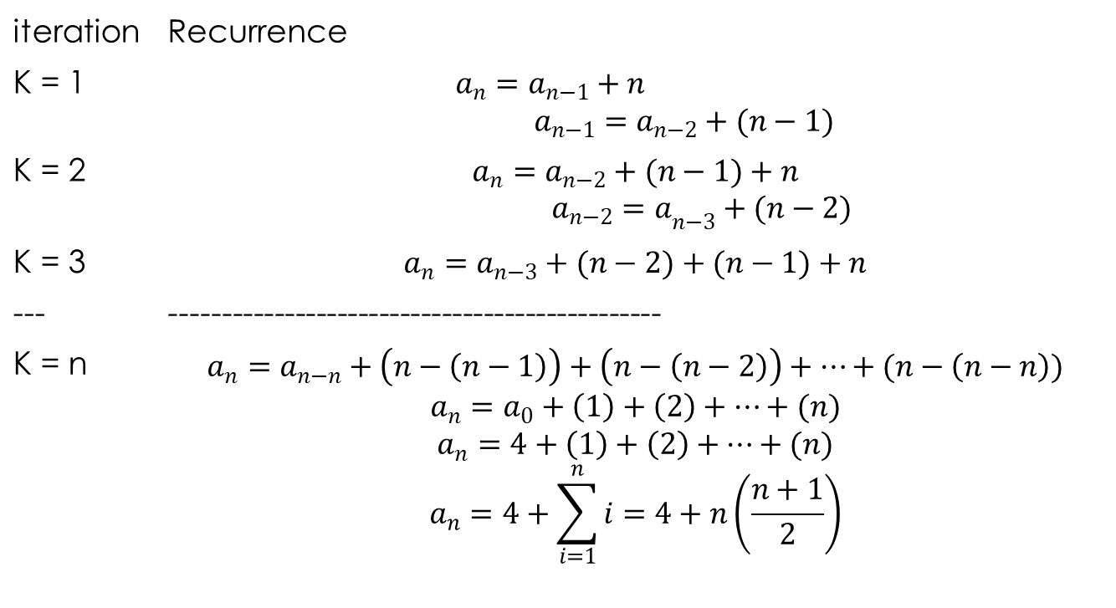

Solving Recurrent Relations: Iteration technique
Example 1: Solve the recurrent relation $a_{n}=a_{n−1}+n, a_{0}=4$
iteration | Recurrence
K = 1 | $a_{n}=a_{n−1}+n$ $a_{n−1}=a_{n−2}+(n−1)$
K = 2 | $$a_{n}=a_{n−2}+(n−1)+n$$ ${a_{n−2}=a}_{n−3}+(n−2)$
K = 3 | $$a_{n}=a_{n−3}+(n−2)+(n−1)+n$$
--- | -----------------------------------------------
K = n | $$a_{n}=a_{n−n}+\left(n−\left(n−1\right)\right)+\left(n−\left(n−2\right)\right)+…+(n−\left(n−n\right))$$ $$a_{n}=a_{0}+\left(1\right)+\left(2\right)+…+(n)$$ $$a_{n}=4+\left(1\right)+\left(2\right)+…+(n)$$ $$a_{n}=4+\sum_{i=1}^{n}{i=4+n\left(\frac{n+1}{2}\right)}$$

Slide 6
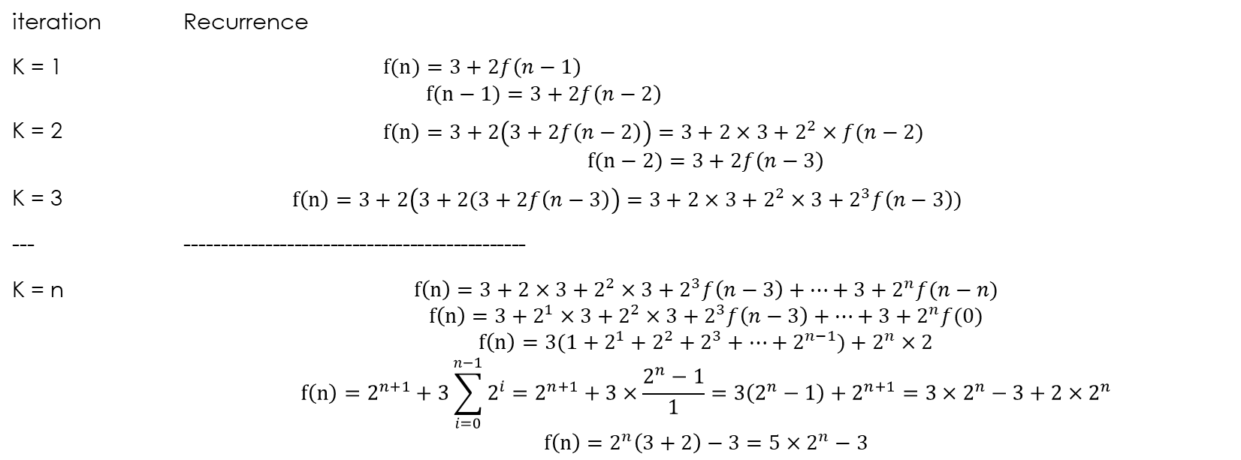
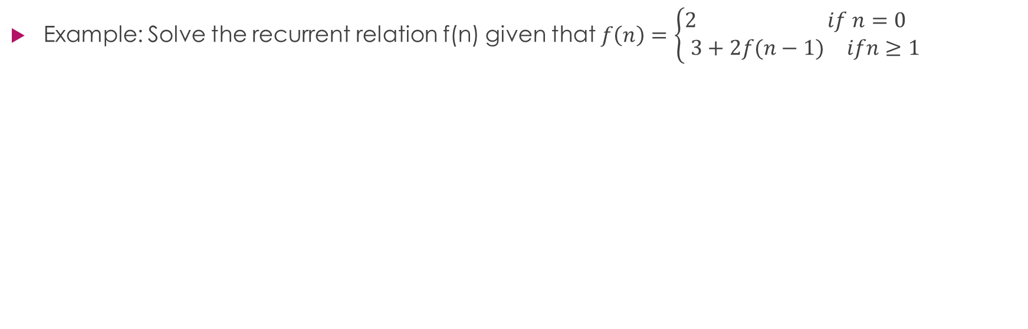
Solving Recurrent Relations: Iteration technique
Example: Solve the recurrent relation f(n) given that $f\left(n\right)=\left\{\begin{matrix}\begin{matrix}2 & if n=0\end{matrix} \\ \begin{matrix}3+2f(n−1) & ifn≥1\end{matrix}\end{matrix}\right.$
iteration | Recurrence
K = 1 | $f(n)=3+2f\left(n−1\right)$ $f(n−1)=3+2f\left(n−2\right)$
K = 2 | $f\left(n\right)=3+2\left(3+2f\left(n−2\right)\right)=3+2×3+2^{2}×f(n−2)$ $$f(n−2)=3+2f\left(n−3\right)$$
K = 3 | $f\left(n\right)=3+2\left(3+2(3+2f\left(n−3\right)\right)=3+2×3+2^{2}×3+2^{3}f\left(n−3\right))$
--- | -----------------------------------------------
K = n | $$f\left(n\right)=3+2×3+2^{2}×3+2^{3}f\left(n−3\right)+…+3+2^{n}f(n−n)$$ $$f\left(n\right)=3+2^{1}×3+2^{2}×3+2^{3}f\left(n−3\right)+…+3+2^{n}f(0)$$ $$f\left(n\right)=3(1+2^{1}+2^{2}+2^{3}+…+2^{n−1})+2^{n}×2$$ $$f\left(n\right)=2^{n+1}+3\sum_{i=0}^{n−1}{2^{i}=2^{n+1}+3×\frac{2^{n}−1}{1}=3\left(2^{n}−1\right)+2^{n+1}=3×2^{n}−3+2×2^{n}}$$ $$f\left(n\right)=2^{n}\left(3+2\right)−3=5×2^{n}−3$$

Slide 7
Solving Recurrent Relations: Substitution technique
There are two types of substitution methods-
  Forward Substitution
  Backward Substitution

Slide 8
Solving Recurrent Relations: Forward Substitution
It is called Forward Substitution because here we substitute recurrence of any term into next terms. It uses following steps to find Time using recurrences-
  Pick Recurrence Relation and the given initial Condition
  Put the value from previous recurrence into the next recurrence
  Observe and Guess the pattern and the time
  Prove that the guessed result is correct using mathematical Induction.
Example: Given T(n) = T(n-1) + n, n>1 , T(n) = 1, n=1 use forward substitution technique to determine the time complexity of the recurrent relation.

Slide 9
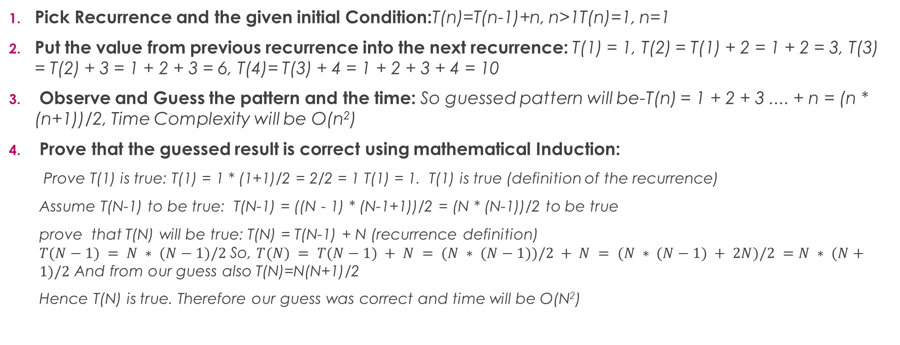
Solving Recurrent Relations: Forward Substitution
Pick Recurrence and the given initial Condition:T(n)=T(n-1)+n, n>1T(n)=1, n=1
Put the value from previous recurrence into the next recurrence: T(1) = 1, T(2) = T(1) + 2 = 1 + 2 = 3, T(3) = T(2) + 3 = 1 + 2 + 3 = 6, T(4)= T(3) + 4 = 1 + 2 + 3 + 4 = 10
Observe and Guess the pattern and the time: So guessed pattern will be-T(n) = 1 + 2 + 3 .... + n = (n * (n+1))/2, Time Complexity will be O(n²)
Prove that the guessed result is correct using mathematical Induction:
  Prove T(1) is true: T(1) = 1 * (1+1)/2 = 2/2 = 1 T(1) = 1. T(1) is true (definition of the recurrence)
  Assume T(N-1) to be true: T(N-1) = ((N - 1) * (N-1+1))/2 = (N * (N-1))/2 to be true
  prove that T(N) will be true: T(N) = T(N-1) + N (recurrence definition)
  $T(N−1) = N ∗ (N−1)/2$So, $T(N) = T(N−1) + N = (N ∗ (N−1))/2 + N = (N ∗ (N−1) + 2N)/2 =N ∗ (N+1)/2$ And from our guess also T(N)=N(N+1)/2
  Hence T(N) is true. Therefore our guess was correct and time will be O(N²)

Slide 10
Solving Recurrent Relations: Backward Substitution
t is called Backward Substitution because here we substitute recurrence of any term into previous terms. It uses following steps to find Time using recurrences-
  Take the main recurrence and try to write recurrences of previous terms
  Take just previous recurrence and substitute into main recurrence
  Again take one more previous recurrence and substitute into main recurrence
  Do this process until you reach to the initial condition
  After this substitute the the value from initial condition and get the solution
Example: Given the following recurrent relation T(n) = T(n-1) + n, n>1T(n) = 1, n = 1, use backward substitution technique to determine the time complexity of the recurrent relation.

Slide 11
Solving Recurrent Relations: Backward Substitution
Take the main recurrence and try to write recurrences of previous terms: T(n) = T(n-1) + nT(n-1) = T(n-2) + n - 1T(n-2) = T(n-3) + n – 2
Take just previous recurrence and substitute into main recurrence: put T(n-1) into T(n)So, T(n)=T(n-2)+ n-1 + n
Again take one more previous recurrence and substitute into main recurrence: put T(n-2) into T(n)So, T(n)=T(n-3)+ n-2 + n-1 + n
Do this process until you reach to the initial condition: So similarly we can find T(n-3), T(n-4)......and so on and can insert into T(n). Eventually we will get following: T(n)=T(1) + 2 + 3 + 4 +.........+ n-1 + n
After this substitute the the value from initial condition and get the solution: Put T(1)=1, T(n) = 1 +2 +3 + 4 +..............+ n-1 + n = n(n+1)/2. So Time will be O(N²)

Slide 12
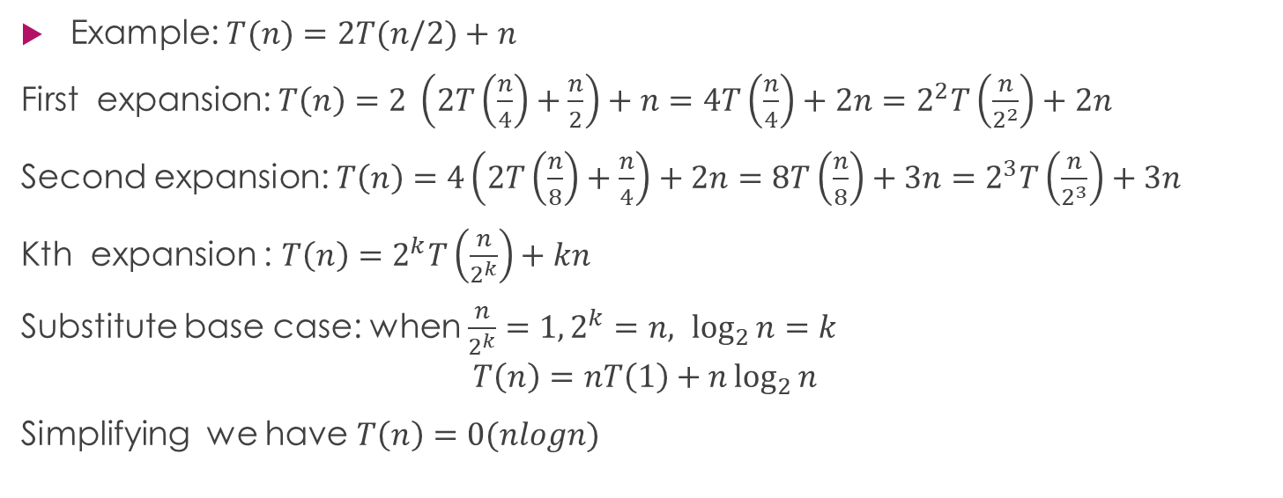
Solving Recurrent Relations: Substitution technique
Example: $T(n)=2T(n/2)+n$
First expansion: $T\left(n\right)=2 \left(2T\left(\frac{n}{4}\right)+\frac{n}{2}\right)+n=4T\left(\frac{n}{4}\right)+2n=2^{2}T\left(\frac{n}{2^{2}}\right)+2n$
Second expansion: $T\left(n\right)=4\left(2T\left(\frac{n}{8}\right)+\frac{n}{4}\right)+2n=8T\left(\frac{n}{8}\right)+3n=2^{3}T\left(\frac{n}{2^{3}}\right)+3n$
Kth expansion : ${T\left(n\right)=2}^{k}T\left(\frac{n}{2^{k}}\right)+kn$
Substitute base case: when $\frac{n}{2^{k}}=1, 2^{k}=n, \log_{2}{n=k}$
$$T\left(n\right)=nT\left(1\right)+n\log_{2}{n}$$
Simplifying we have $T\left(n\right)=0(nlogn)$

Slide 13
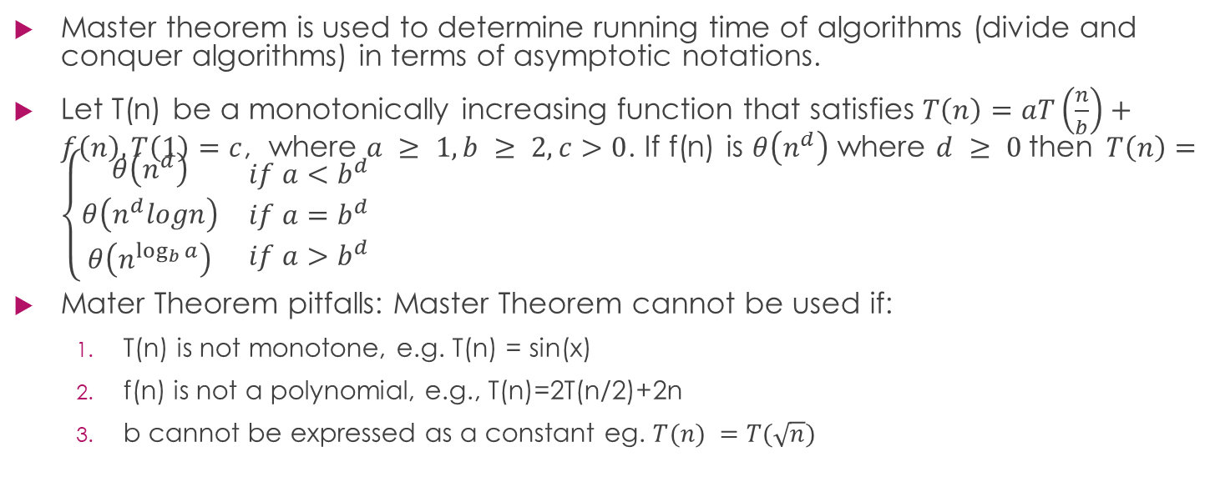
Solving Recurrent Relations: Master Theorem
Master theorem is used to determine running time of algorithms (divide and conquer algorithms) in terms of asymptotic notations.
Let T(n) be a monotonically increasing function that satisfies $T\left(n\right)=aT\left(\frac{n}{b}\right)+f\left(n\right), T\left(1\right)=c$, where $a ≥ 1, b ≥ 2, c>0$. If f(n) is $θ\left(n^{d}\right)$ where $d ≥ 0$then$T\left(n\right)=\left\{\begin{matrix}\begin{matrix}θ\left(n^{d}\right) \\ θ\left(n^{d}logn\right) \\ θ\left(n^{\log_{b}{a}}\right)\end{matrix} & \begin{matrix}if a<b^{d} \\ if a=b^{d} \\ if a>b^{d}\end{matrix}\end{matrix}\right.$
Mater Theorem pitfalls: Master Theorem cannot be used if:
  T(n) is not monotone, e.g. T(n) = sin(x)
  f(n) is not a polynomial, e.g., T(n)=2T(n/2)+2n
  b cannot be expressed as a constant eg. $T(n) =T(\sqrt{n})$

Slide 14
Master Theorem:Example

